Slide 1
Workshop
State of Washington
Mar 10, 2022

Slide 2
3 session agenda
Session #1 - learning session
↪ Overview, methods, and goals
Session #2 - small group work session
↪ Product vision, roadmap review, and decision points
Sessions #3 - small group work session
↪ QASP review + RFQ Drafting!

Slide 3
WA HHS Coalition milestones
Jan - Mar 2022 | Apr - Jun 2022 | Apr-June 2022 | Jul-Sept 2022
Platform and Product 1 RFPs are written + shared w/ CMS Identify and prioritize questions that need to be answered to enable best collaboration with vendors Start prep for M&O recompete | Hiring and staffing internal positions RFPs are released Licences + environments start getting set up as possible Conduct research + collaboration sessions to answer questions + prep for vendors Start drafting M&O recomplete RFP | Vendors evaluated + selected Contracts approved by CMS + executed Prep for next DP begins M&O Recompete RFP is out Begin business + policy processes to create streamlined application | Vendors start work Next DP is submitted M&O vendor(s) selected

Slide 4
Agile Contract Format
Background & purpose
Scope & objectives
Contract period of performance (PoP), place of performance, and contract type
Operating constraints
Instruction & evaluation
‹#›
Notes:
Why did we create this? We needed a crosswalk between the contracting world and the development world.

Slide 5
Agile Contract Format
Background & purpose
Session #1
Session #2
Session #3
Scope & objectives
Contract period of performance (PoP), place of performance, and contract type
Operating constraints
Instruction & evaluation
‹#›
Notes:
Why did we create this? We needed a crosswalk between the contracting world and the development world.

Slide 6
Session #1 agenda
Break
Break
Intros + norms
Intro to agile and product ownership
HCD and DevOps 101
Agile acquisitions
Reflection + next steps

Slide 7







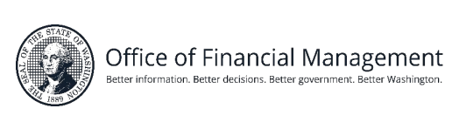
Welcome! We are honored to work with you.

Slide 8
18F is a digital services consultancy for government, inside the U.S. government.
(We’re federal employees.)

Slide 9
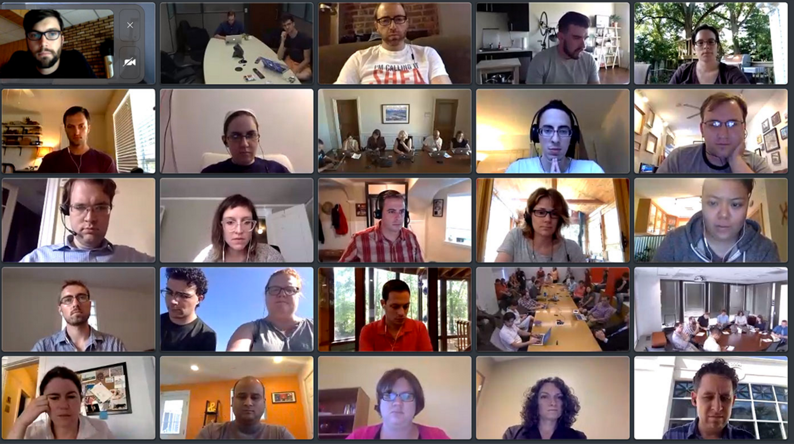
We help agencies build, buy, and share the best digital government services available.

Slide 10




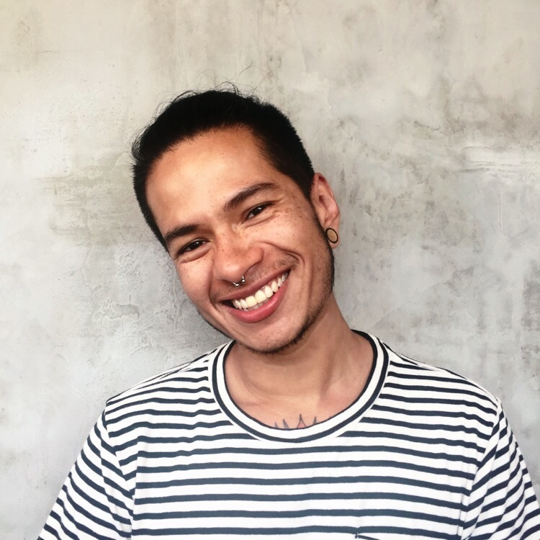


Your 18F team
Nina Mak
Product Management Lead
Greg Walker
Consulting Engineer + Project lead
Randy Hart
Acquisition Lead
Austin Hernandez
Senior Product Designer
Amy Ashida
Principal Consultant
Erica Vosseller
Account Manager

Slide 11
Who is here today?
Write in the chat:
Your name
Your division and program
Your role in this meeting
One thing that makes you proud to work for your organization

Slide 12
Session norms
During this time we’re aiming to build shared understanding of goals, ways of working, and paths forward. How will we as a group behave to make that possible?
Take space + make space for others
Be comfortable with silence
Put challenges in the middle of the table for consideration by all
Interrupt with questions
We’ll maintain a parking lot of things to come back to

Slide 13
A quick poll to get us started

Slide 14
Agile & Agile misconceptions

Slide 15

Waterfall development
Introduced by Winston Royce in 1970, Managing the Development of Large Software Systems
Plan
Gather requirements
Design
Code
Test
Release
Notes:
Presented at the IEEE WESCON conference and published in the journal proceedings afterwards, so it was basically industry gospel as a result.

Slide 16
Waterfall development
Introduced by Winston Royce in 1970, Managing the Development of Large Software Systems
He showed a variation of this diagram. It’s right after the 4th paragraph of the paper. Just before the 5th paragraph.
Plan
Gather requirements
Design
Code
Test
Release
Notes:
I mean, he got right to it. He explained waterfall right off the bat.

Slide 17
Waterfall development
Introduced by Winston Royce in 1970, Managing the Development of Large Software Systems
He showed a variation of this diagram. It’s right after the 4th paragraph of the paper. Just before the 5th paragraph.
The 5th paragraph begins by saying it won’t work.
Plan
Gather requirements
Design
Code
Test
Release

Slide 18
Waterfall development
Introduced by Winston Royce in 1970, Managing the Development of Large Software Systems
He showed a variation of this diagram. It’s right after the 4th paragraph of the paper. Just before the 5th paragraph.
The 5th paragraph begins by saying it won’t work.
We never should have done this.
Plan
Gather requirements
Design
Code
Test
Release

Slide 19
Waterfall development
Introduced by Winston Royce in 1970, Managing the Development of Large Software Systems
He showed a variation of this diagram. It’s right after the 4th paragraph of the paper. Just before the 5th paragraph.
The 5th paragraph begins by saying it won’t work.
We never should have done this.
The guy who identified it said so.
Plan
Gather requirements
Design
Code
Test
Release

Slide 20
Waterfall development
Introduced by Winston Royce in 1970, Managing the Development of Large Software Systems
He showed a variation of this diagram. It’s right after the 4th paragraph of the paper. Just before the 5th paragraph.
The 5th paragraph begins by saying it won’t work.
We never should have done this.
The guy who identified it said so.
He said we should be iterative, but we basically ignored him until 2001.
Plan
Gather requirements
Design
Code
Test
Release
Notes:
The Agile Manifesto was published in the early months of 2001. That’s where modern iterative development can find its roots, which is unfortunate because Dr. Royce had suggested it to us 30 years prior.

Slide 21
Agile is not only a way of working, it’s a way of thinking and acting, it’s our aspiration to build products faster, in a collaborative manner and, with the Customer on the center of our thoughts.”
João Baptista Leite, CEO, Unicre – Instituição Financeira de Crédito, S.A.
Notes:
Agile is a product development methodology based on iterative development, where solutions evolve through learning and collaboration over time.
Requirements and solutions evolve through collaboration between self-organizing, cross-functional teams. This means you have a small group of skilled, self-motivated people who build a functioning product every couple of weeks or so, making it better each time.
You’ll keep hearing these themes today. Product development, iterative evolution, learning over time.

Slide 22
Agile vs waterfall

Slide 23

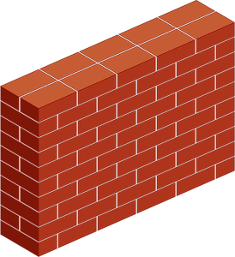



Waterfall and the walls
Requirements
Design
Code
Users
Notes:
In waterfall, each phase is basically trying to create a set of specifications for the next step to work with. The outputs are specifications. It’s like that guy in the movie Office Space, right? He takes the requirements from the customer and gives them to the product team. But why is he even there, really? Why can’t the users give their requirements directly to the product team?

Slide 24

Agile comes in like a wrecking ball

Slide 25
Agile comes in like a wrecking ball
Notes:
The Agile manifesto says to prefer individuals over processes, to prefer responsiveness to change over adherence to a plan, to customer collaboration over a strict contract. You can’t get those things with walls between people. You need your users close to your designers close to your developers. They all need to be directly talking to and hearing from each other, routinely.

Slide 26
Agile keeps stakeholders in the loop
Notes:
The product team is working closely together in the day-to-day, but other stakeholders aren’t excluded. Typically agile works in sprints, but whatever you call it, it’s when you deliver another iteration. Often it’s every two weeks, and it’s concluded with a demo of what you’ve accomplished during the sprint. It’s a great time for stakeholders outside the product team to give feedback. So, for examples, executives don’t have to be involved every day, but maybe an hour every couple of weeks they get a quick pulse-check. There are also other points in the process that are intended to bring in more stakeholder engagement, like updating the roadmap and things like that.

Slide 27
Agile is full of loops
Design
Test
Test
Code
Release
Test
Notes:
Waterfall is linear by nature. Most waterfall methodologies do permit going backwards to previous steps, but the whole project has to go back, not just a single feature or whatever. They’re also not clear about what triggers going back.
An agile approach treats each feature or user story as a distinct unit of work, and it also doesn’t strictly define how that unit moves through the various steps. So long as it’s informed by some kind of test - whether that’s user research, integration tests, accessibility tests, whatever - any kind of test that can teach you something new about what you’re working on, you can do whatever piece of the work is more relevant for that feature at the moment.

Slide 28
Agile misconceptions
Common assumptions made about agile and what we mean

Slide 29
Common misconceptions:
Starting small means one piece at a time
Agile means less planning
Agile means less/no documentation
Agile is fast/less work

Slide 30
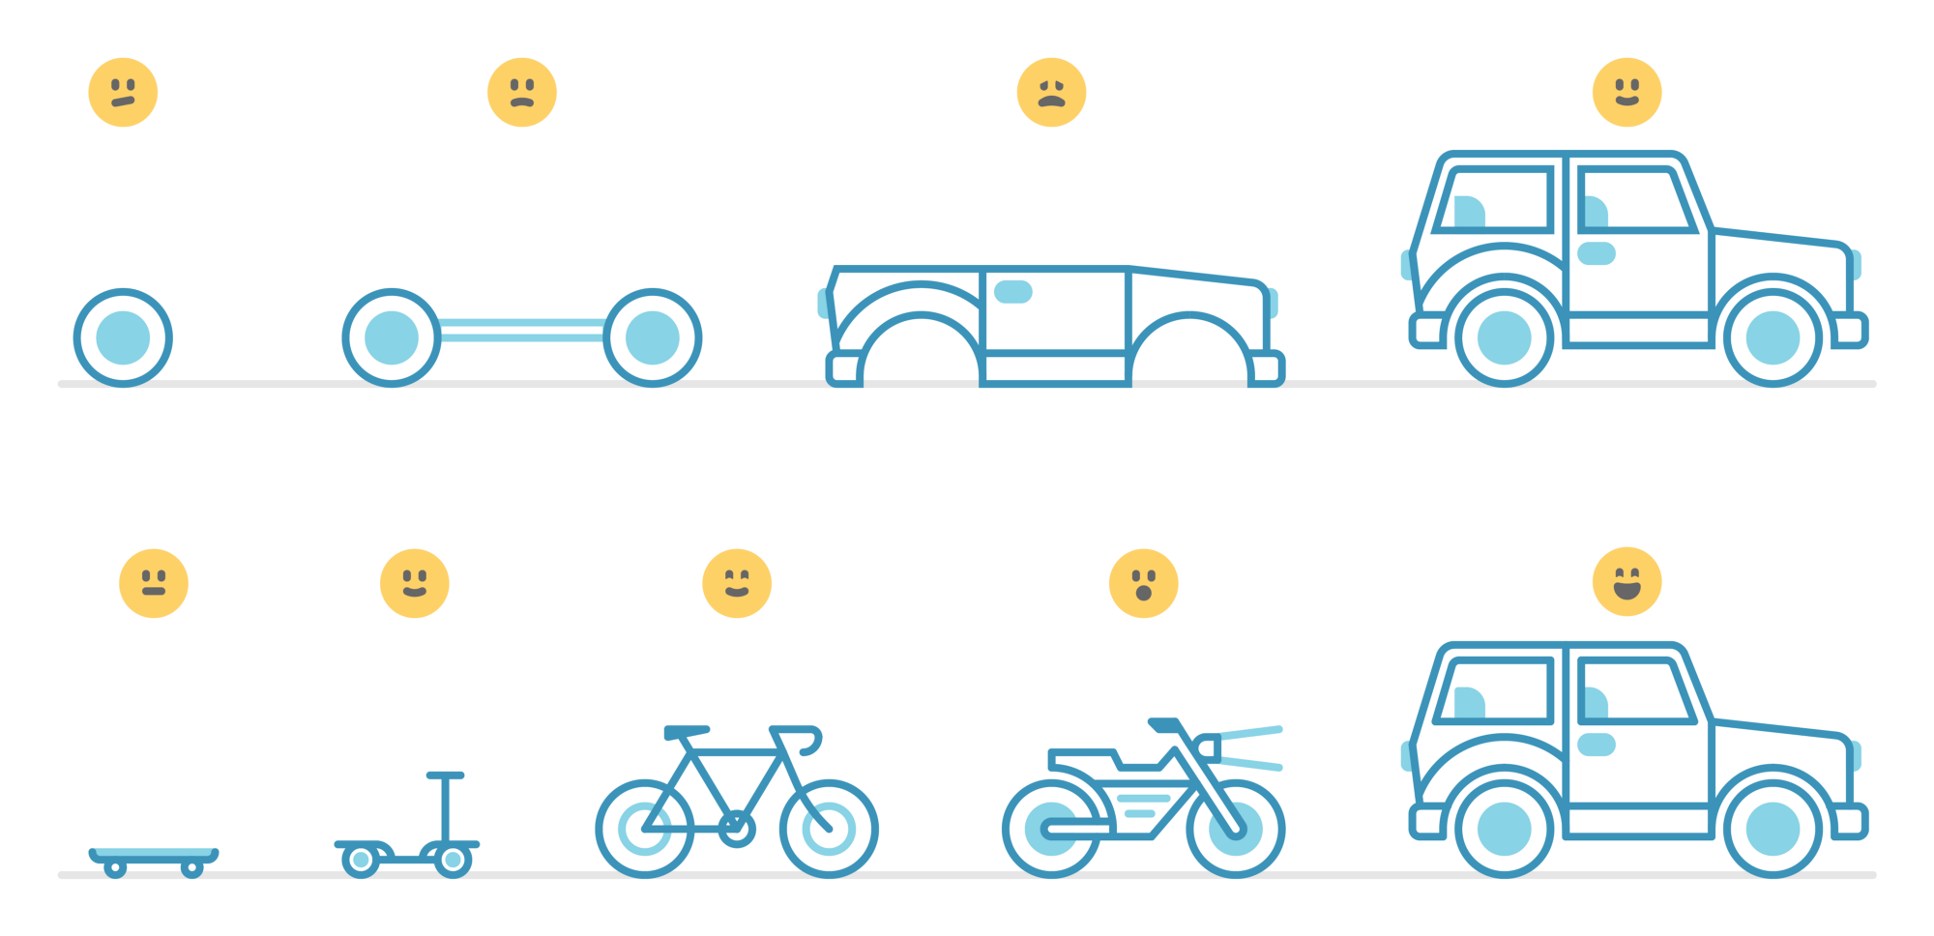
Starting small does not mean one piece at a time
Notes:
This is Amy: I kinda like the jobs to be done framework here using the example of the job to be done is going to get groceries and testing w/ users along the way.
Skateboard - could get user to the grocery store faster than walking, but still high effort and awkward to carry things home
Scooter - slightly less effort than skateboard, but still takes a long time
Bike - faster than skateboard, some cargo but not enough for a large purchase or to bring a friend
Motorcycle - fast! But feels unsafe - still lacking cargo space
Car - fast! Feels safer, can bring friends and carry a week of groceries

Slide 31
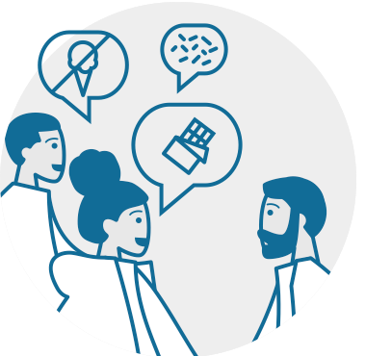
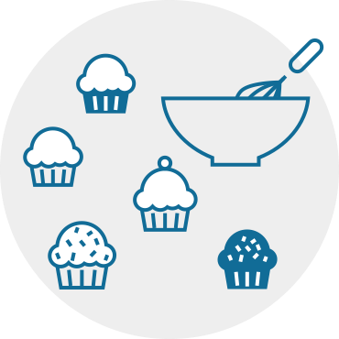
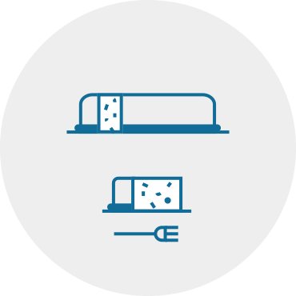
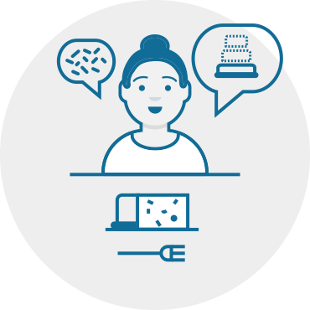
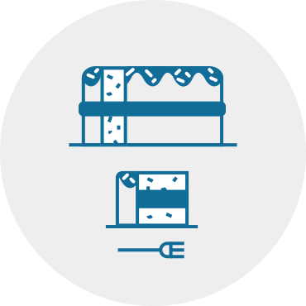

Agile does not mean no/less planning
Learn about users
Make prototypes and test them
Build a small version of the real thing
Get feedback from real users
Use feedback to adjust and improve
Rinse and repeat!
Notes:
Agile does not mean no/less planning. You still need to have some sense of where you’re going and how you’re going to get there, and you need to plan to learn. You have a bakeoff/potluck, you need to go to the store… but you are trying new recipe / trying new flavor combos, you dont know what anyone likes…
(Constantly deliver value)
The cupcake example is more in line with what you really do in iterative development. Every phase you have something closer to delivering the value you think you want to achieve. If you’re going in the wrong direction, hey! Maybe cakes aren’t the right thing! Maybe everyone actually prefers a different dessert?

Slide 32
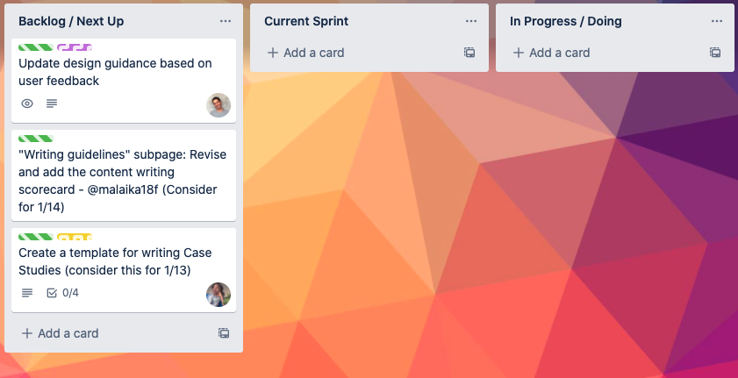
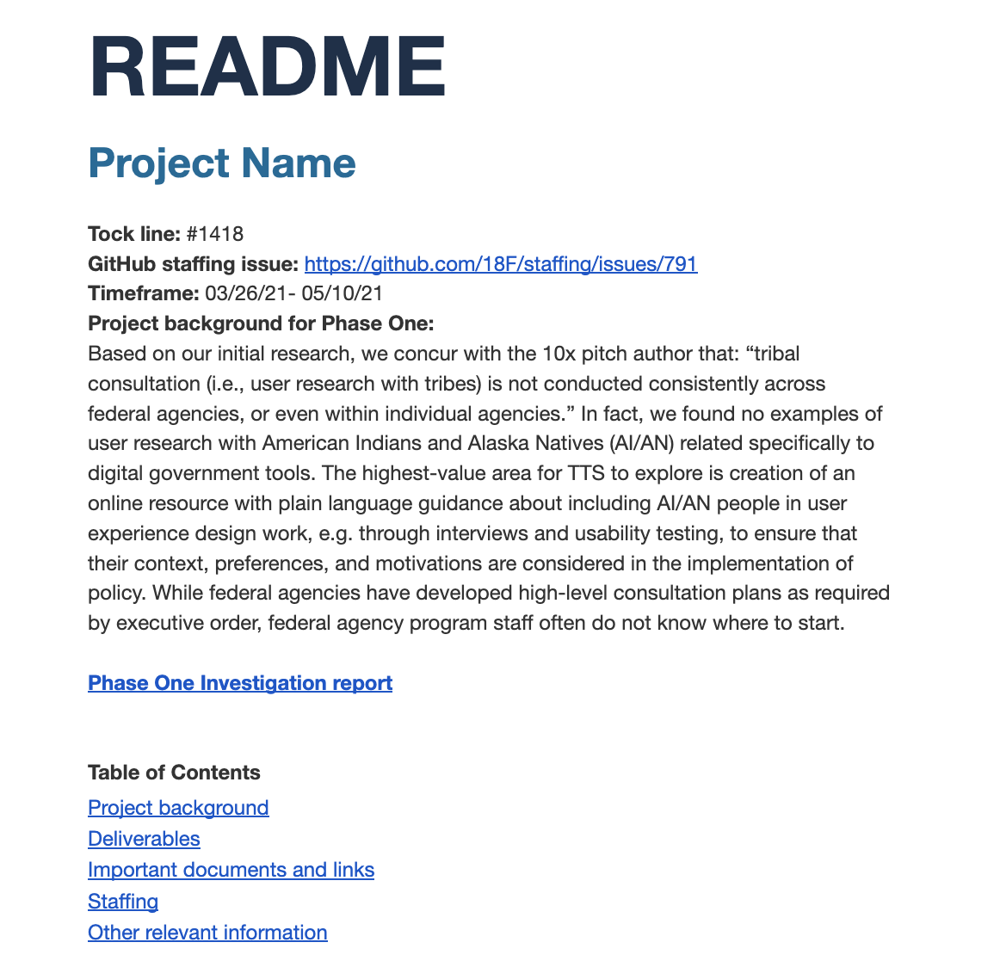
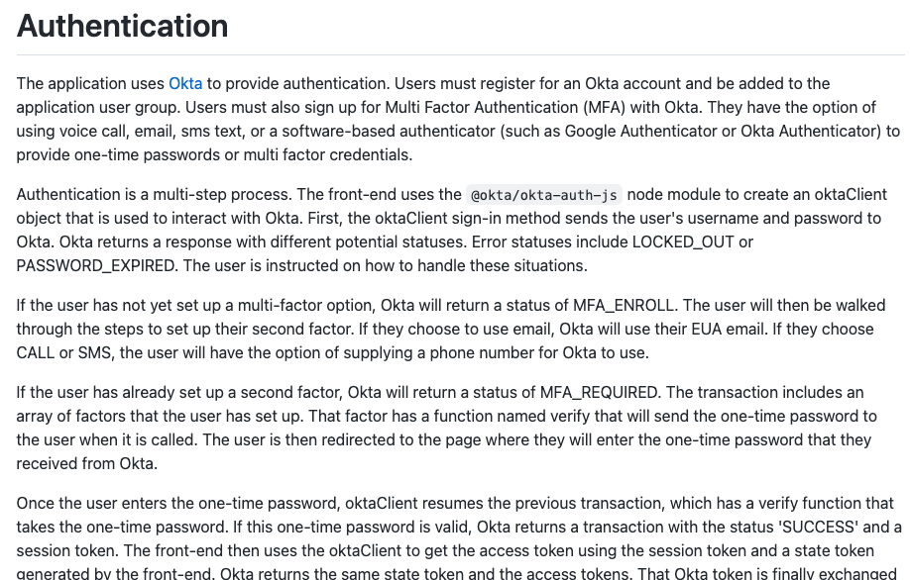
Agile does not mean no/less documentation
Transparency of work and team capacity
Shared vision/goals
Clear idea of what has happened and what needs to be done
Less rework and duplication of work
Technical and research findings for future teams

Slide 33
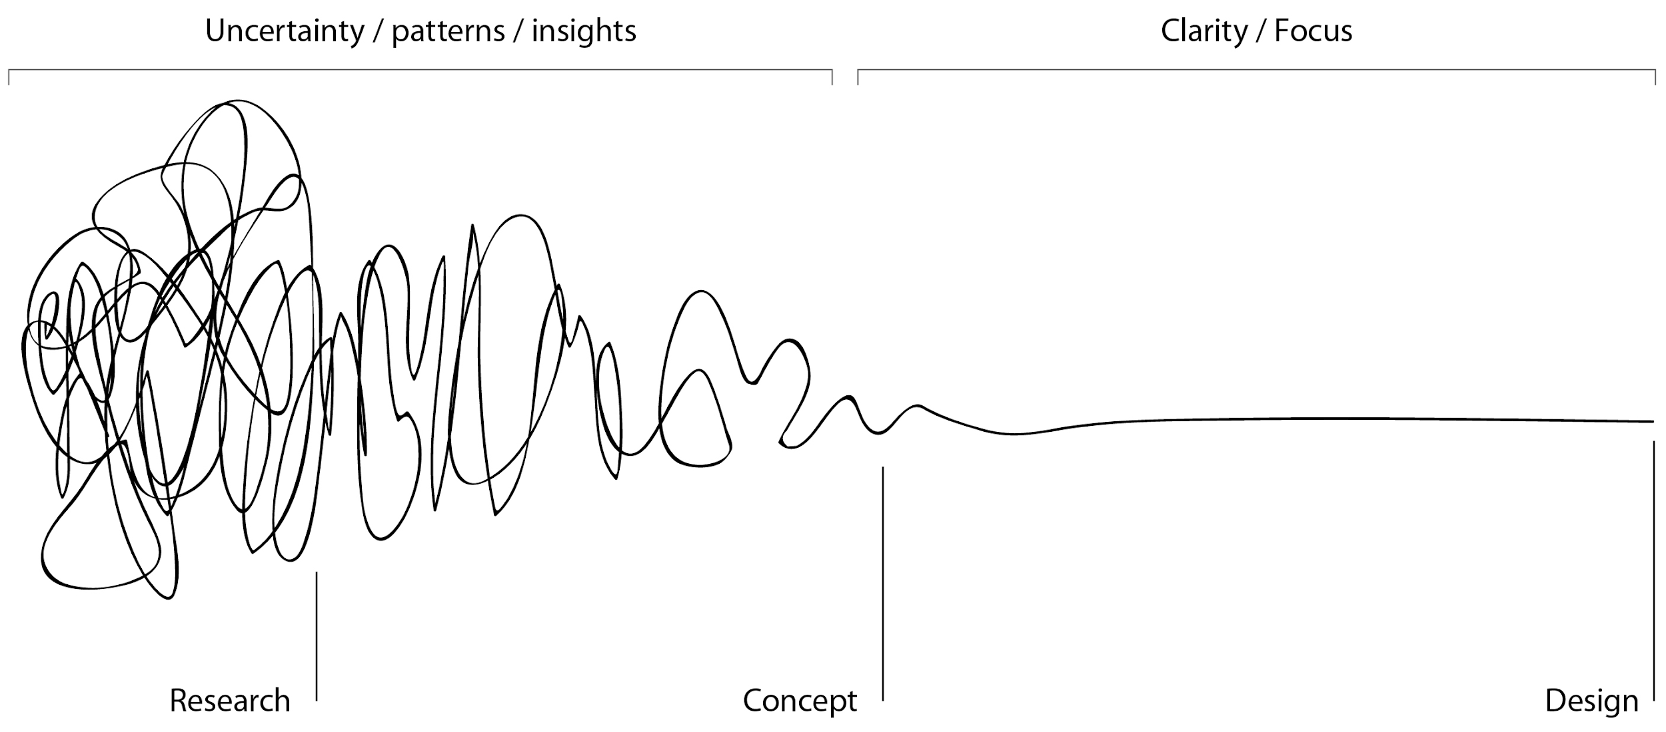
Agile is not (necessarily) fast/less work
More discovery work upfront
To avoid rework and costly oversights
Notes:
Because it’s the same amount of work, it still takes time.

Slide 34
Product ownership
Moving toward successful outcomes (not output)
Notes:
We've been pretty basic and high-level so far, and we're going to start getting into how do you enable this way of working
In a world in which everything isn’t planned upfront, but you still need some plans, what does that look like? And how are you making sure you’re building the right thing? This is where the Product Owner comes in. The PO’s role isn’t to make sure the team is completing a pre-determined set of outputs, a checklist of tasks. Instead, the PO is focused on defining the outcomes they want the team to focus on achieving.

Slide 35
Who owns the vision? The strategy?
The State of Washington
Notes:
Historically, a lot of government agencies have outsourced product ownership to their vendor teams. This typically leads to the government either not quite knowing what’s getting built, being surprised or disappointed by what gets built, and/or getting locked in to a vendor because all the knowledge resides with them. Instead, in this model, the state of WA is owning the vision and the strategy for the product.

Slide 36
Product uses that positioning to answer two questions:
What should we do? Why?
Vision
Notes:
The Product Owner, then, is the person from the State of Washington who is responsible for answering what should we do and why, which is the vision

Slide 37
Product uses that positioning to answer two questions:
What should we do? Why?
How do we get there?
Vision
Execution
Notes:
And how do we get there, which is the execution. “Vision” isn’t about features. It’s the job that users hire the product for. Features are what execution is about.

Slide 38
Product owners collaborate with team members and stakeholders to create a shared vision, then communicate it internally and externally.
Notes:
To set the vision, POs are collaborating with different team members and stakeholders to understand what problems or opportunities are important to focus on and what impact you want to have and for who. We’ll talk more about vision statements on Monday, but they’re usually expressed in a high-level sentence or two talking about how we want the world to be.
18F’s organizational vision: We envision a country whose government consistently offers digital services that instill pride and trust, meet user needs, are secure, and are delivered quickly and at reasonable cost.
Uber’s vision: “Imagine a city that reclaims the space once wasted on garages and lots and meters to build new parks and schools and housing. Imagine a city where you can choose to live or start a business anywhere you want, because transportation to and from will always be one tap away.”
Once you’re aligned on a shared vision, the POs are responsible for making sure everyone is clear on what that vision is and stays focused on working towards it.

Slide 39
From the vision, product owners create strategy, roadmap, and feature definition of a product.
Notes:
From the vision, product owners define a plan for achieving that vision. They work with their team to identify options and make a recommendation about a path forward. They then define the key features needed to implement that strategy, and they prioritize the work, communicating the overall plan via a roadmap.
We always need a strategy to start, but it’s important to remember that the strategy and roadmap are not a promise, they’re a prediction. They may change as we learn more, or as the world changes, and that’s ok. They communicate our best guess of where we’re going and how we’re going to get there, and we should adjust as needed.

Slide 40
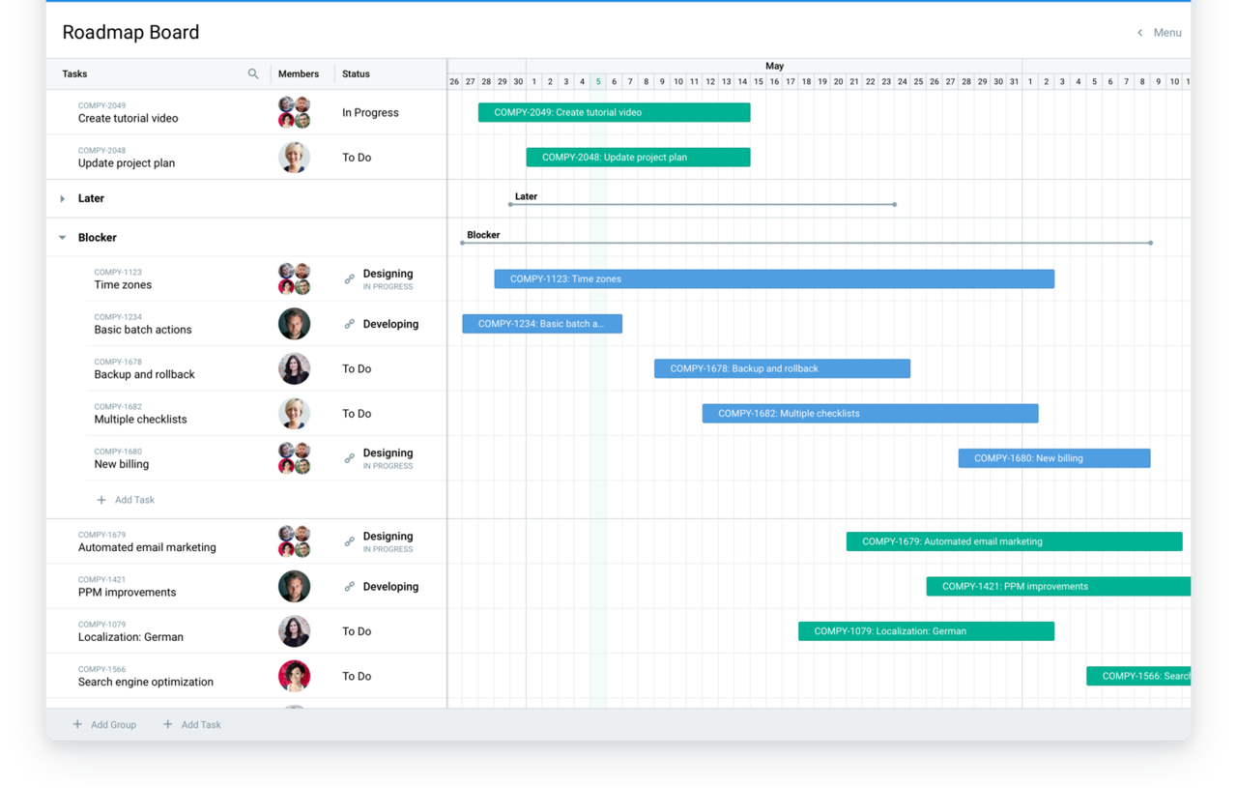
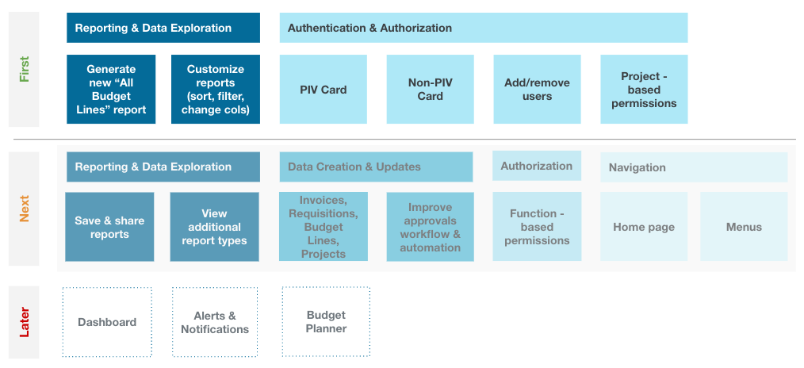
Product roadmaps are a powerful tool for product teams charting out a strategic plan
Notes:
We’ll talk more about roadmaps on Monday, but the important thing to remember is that it’s a powerful tool for charting and communicating out your strategic plan — to your team, to your stakeholders, to executives and legislators, and to your public.
The product roadmap can take many forms, there’s no one right way. You may even have different forms of your roadmap tailored to different audiences and what they need to know.
This roadmap on the left breaks things down at a very granular level and provides an indication of when during the year each item will be worked on.
The roadmap on the right is higher-level, and talks about what will be worked on first, next, and later

Slide 41
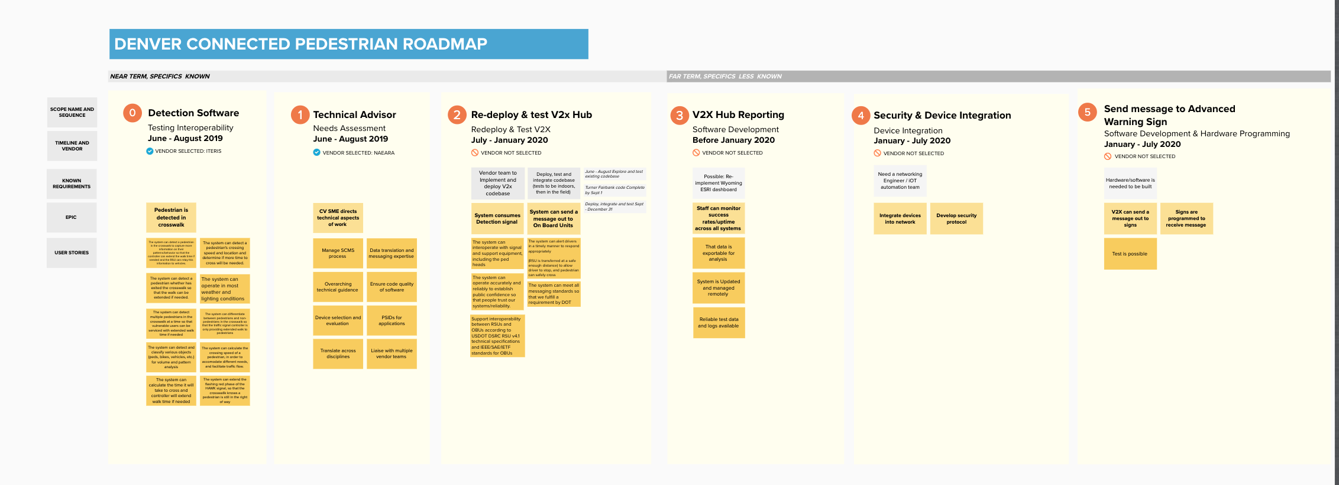
Product roadmaps communicate priorities and sequence
Notes:
The important thing is that they help you communicate what your priorities are and what’s the sequence you plan to work on things.
They should have more detail for things you’re working on now, like the first 3 sections of this roadmap, and just a broader sense of goals for things further down the road, like the last 3 sections of this roadmap.
They are not overly prescriptive and are regularly updated. Roadmaps guide the work through much uncertainty that is resolved through iteration, discovery and the software development process

Slide 42
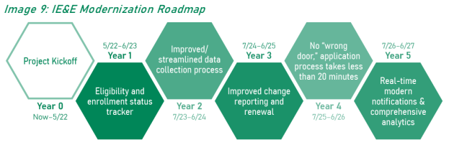
Status Tracker Roadmap
First
Next
Later
Notes:
And for a project as large as IE&E, you should expect to have multiple, nested roadmaps. You already have an overall IE&E roadmap, where the status tracker and the platform are the first items to be worked on. Soon you’ll have a roadmap for the status tracker, which will map out at a more granular level what you can expect to get worked on, when for that specific product.
The Status Tracker Roadmap is influenced by the IE&E Roadmap, and the IE&E Roadmap is influenced by what happens and what you learn with the Status Tracker. So you’ll need a way for these to stay in sync. You’ll have to figure out who is going to be responsible for proposing updates and refinements to the IE&E roadmap as you move forward and figure more things out.

Slide 43
The roadmap is a bridge between your strategic vision and your backlog of work
Notes:
But not matter what form your roadmap takes, it serves as a bridge between your strategic vision and your backlog of work. It helps you keep track of the big picture and tie every piece of work to your end goal.

Slide 44
Product owners protect the project team, scope, and what gets built.
Notes:
Expect from POs that they will protect the team, scope, and what gets built.

Slide 45
Product owners protect the project team, scope, and what gets built.
They should say “no” often, and leadership should give them the space to do so.
Notes:
This likely means they’re saying “no” a lot. And you want them to do that.

Slide 46

Design and execution matter
Notes:
Otherwise, you end up with Homer’s every man car. This car was designed from scratch, and every ask that Homer Simpson made got added to it, resulting in this monstrosity that cost $82,000 and drove the automaker – his half brother Herb – into bankruptcy.
So it’s not so much that POs are saying no as it is that they unwaveringly helping you stay focused on the outcomes you want to achieve and the highest priority work needed to get there

Slide 47
Product owners own four questions:
What’s the problem we’re solving? (and why does it matter?)
What will our impact be?
How are we doing it?
Is our solution good?

Slide 48
What’s the problem we’re solving? (and why does it matter?)
What will our impact be?
How are we doing it?
Is our solution good?

Slide 49
What’s the problem we’re solving? (and why does it matter?)
What will our impact be?
How are we doing it?
Is our solution good?

Slide 50
What’s the problem we’re solving? (and why does it matter?)
What will our impact be?
How are we doing it?
Is our solution good?

Slide 51
What’s the problem we’re solving? (and why does it matter?)
What will our impact be?
How are we doing it?
Is our solution good?

Slide 52
Product teams have to be able to provide good answers to all of these questions. When the answer is “we don’t know”, they need to have a concrete plan to get to an answer.

Slide 53
Product teams have to be able to provide good answers to all of these questions. When the answer is “we don’t know,” they need to have a concrete plan to get to an answer.
Notes:
There are, in fact, many things you don’t know right now. You’ve been focused on answering more pressing questions to get the Roadmap Report put together and then to get the Platform RFP together. As the Product Team is focusing on the Product 1 RFP, they’re uncovering the next layer of questions, and they’ll need your support to work collaboratively with them to make plans to get answers.

Slide 54
user need
stakeholders
Product owners sit at the intersection of design and research, development, business, policy, and politics.
technology
business
Notes:
Because even though we talk about POs being responsible for this work, they rely on close collaboration with various subject matter experts. They sit at the intersection of design and research, development, business, policy, and politics and need to manage conflicting needs.
In the case of Product 1, that means understanding not just what information about enrollment and eligibility status Washingtonians need, but also what are you trying to achieve technologically to make progress towards your IE&E vision, and also what does the organization need to be able to transition to working in a more agile way.
And then finding the intersection that makes sense to pursue in Year 1 that lays the groundwork for future years.
So what this means is that, even though we say that Washington needs a PO, really the PO needs committed team members on the state side to help them understand these different spheres of considerations. The PO cannot be the expert in each of these things, they need to have people who are experts in these areas they can partner closely with, so they can see across the whole set of considerations and find that intersection.

Slide 55
A word of warning: product ownership is a major commitment.

Slide 56
Treating product owners as “other duties as assigned” is not setting the product owner, or the effort, up for success.

Slide 57
Product owners’ days are filled with
Planning and strategizing
Executing and delivering
Maintaining and retrospecting
Defining outcomes
Breaking down the work
Resolving ambiguity
Driving decisions & alignment
Prioritizing
Balancing
Refining the backlog
Writing user stories
Clearing blockers for the team
Reviewing work
Monitoring usage
Soliciting feedback
Prioritizing fixes
Meeting with users
Communicating with stakeholders
Attending usability sessions
Notes:
POs are simultaneously planning/strategizing at roadmap level, executing at individual project level, maintaining previous project outputs, learning/retrospecting about previous project outputs.

Slide 58
Human-centered design
Putting people at the center of all problem solving
Notes:
Going to cover UCD, also known as HCD
High level overview
What it is, why it is useful, and you can use it to improve products
Why it’s everyone’s responsibility not just the design team

Slide 59
Human-centered design helps us design for actual humans who will use what we’re making.
Notes:
Specifically -- real people who will use the thing you make.
UCD is strict about this distinction
if you aren’t designing for and with the people using your product, then you are designing for invented people.
The further away you get from designing for your real users, the less likely you are to meet their needs and goals.

Slide 60
Who are the people you are designing for?
____ who ____
Ex.
A person who receives benefits.

Slide 61

Microsoft’s inclusive design principles:
Solve for one, extend to many.
All humans grow and adapt to the world around them.
Exclusion happens when we solve problems using our own biases.
Include and learn from people with a range of perspectives.
Notes:
They could also be:
A person who has a disability
A person who is recently unemployed
A person who does not have a computer at home

Slide 62
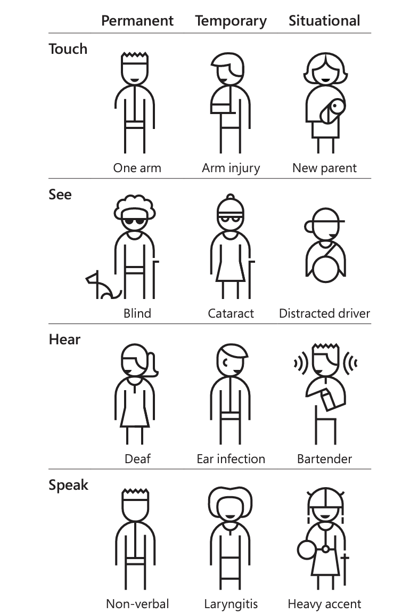
The Persona Spectrum
We use the Persona Spectrum to understand related mismatches and motivations across a spectrum of permanent, temporary, and situational scenarios. It’s a quick tool to help foster empathy and to show how a solution scales to a broader audience.
Courtesy of Microsoft
Notes:
They could also be:
A person who has a disability
A person who is recently unemployed
A person who does not have a computer at home

Slide 63
There’s no one design process but there are consistent patterns.
Notes:
But there are patterns UCD methods have in common.

Slide 64
Courtesy of ReVision Lab
Notes:
One pattern is the process of developing new designs.
UCD projects begin with a lot of research and rapidly experimenting with many ideas.
In this phase - Research goes in many different directions - which is actually good because you are exploring possible solutions.
Clarifying the area that you should focus on and framing the problem.
Refine the best of these ideas and refine them into concepts for design.
Use design to turn concept into new features and functionality.
In UCD, A team has many ideas moving along this pathway.

Slide 65
Concept
Incorporate feedback
ITERATIVE DESIGN
Try it out (“prototype” or “draft”)
Gather feedback (Testing with users and stakeholders)
Notes:
Another pattern is iteration
This diagram shows a ‘design loop’ that your team moves through repeatedly to test and refine their designs.
[Read through steps]
Start with concept
Try it out: implement your concept as a rough prototype
Evaluate it with real users
Incorporate Feedback and revise design
Start again with revised concept

Slide 66
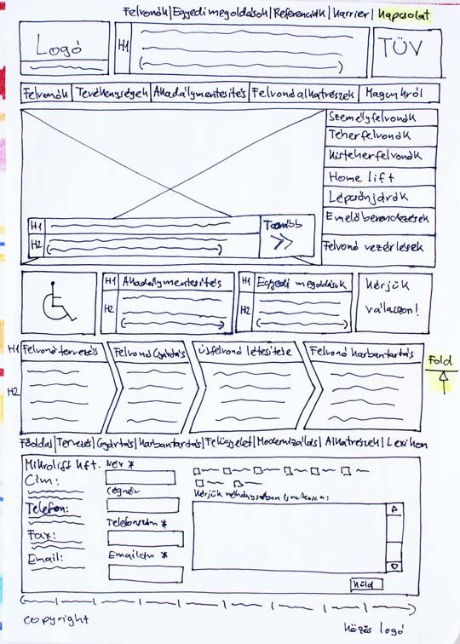
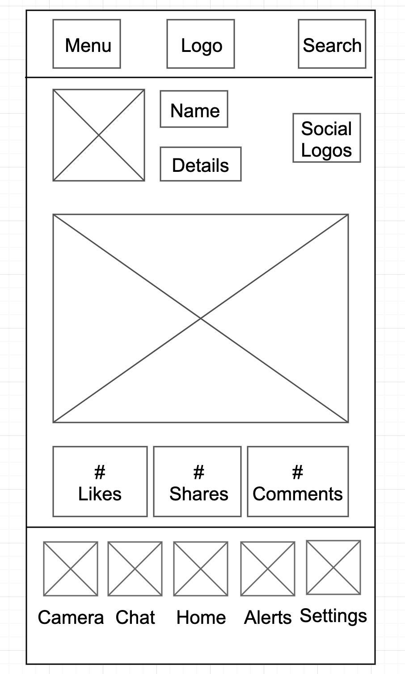
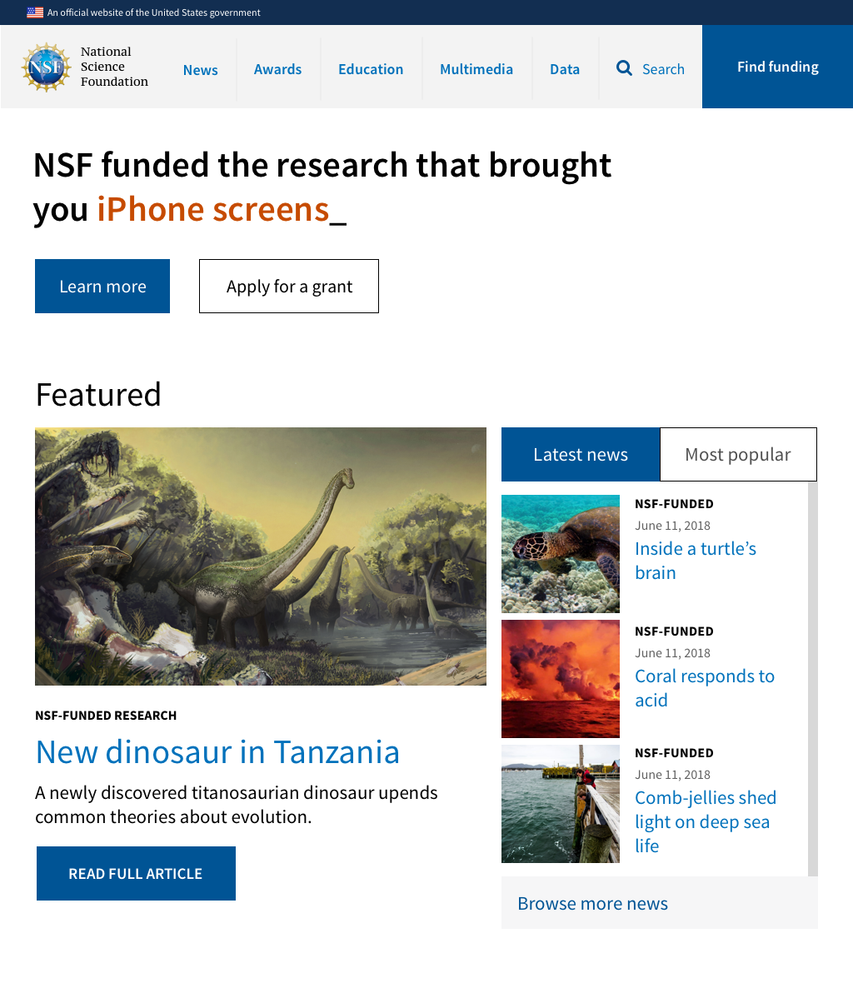
Trying things out doesn't need to be costly
1
2
3

Slide 67

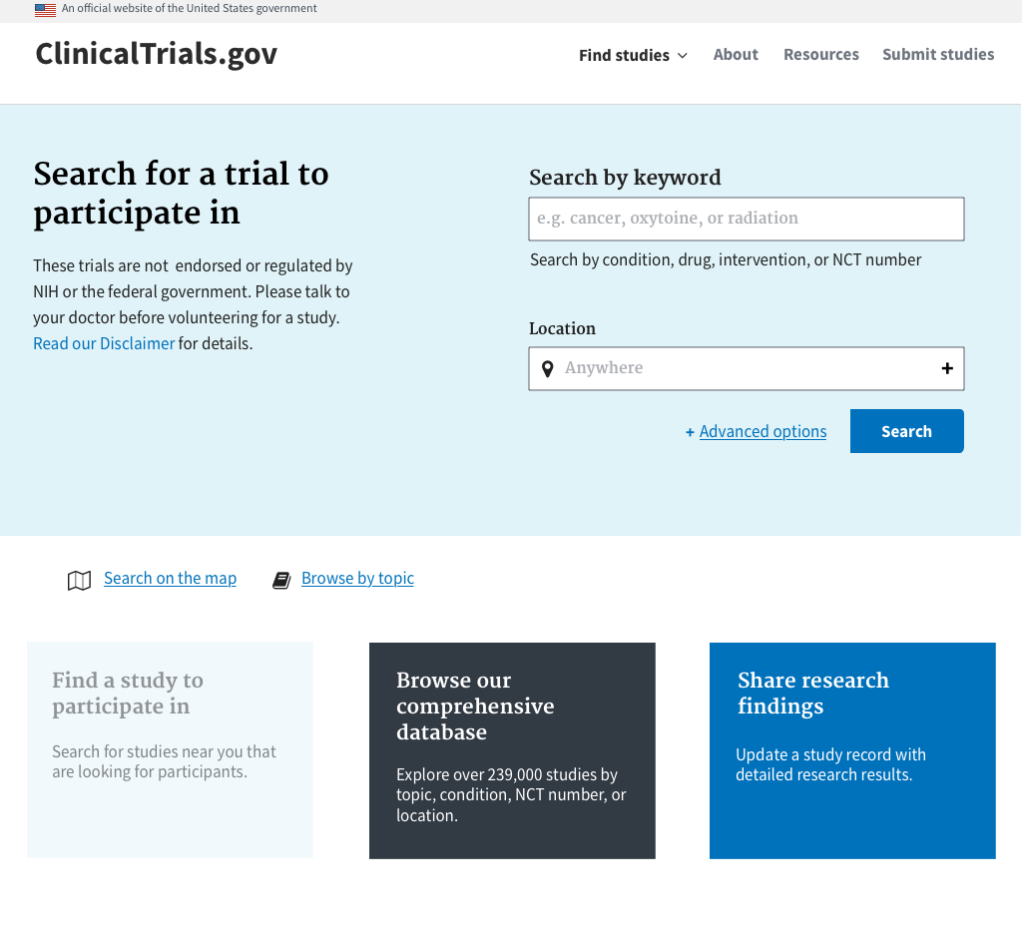
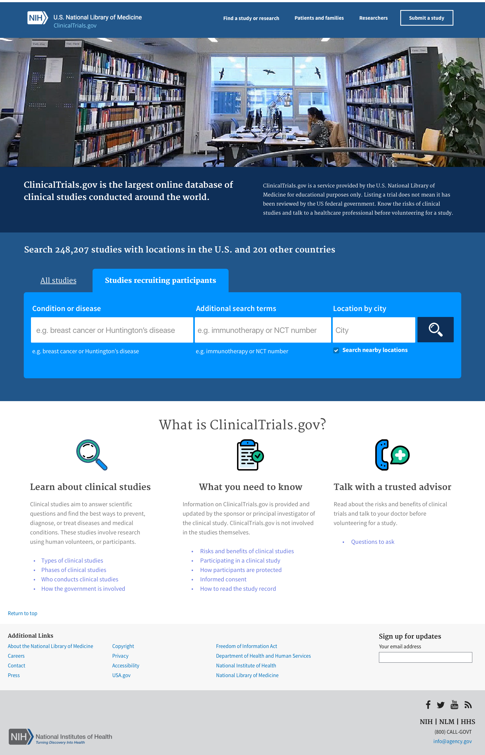
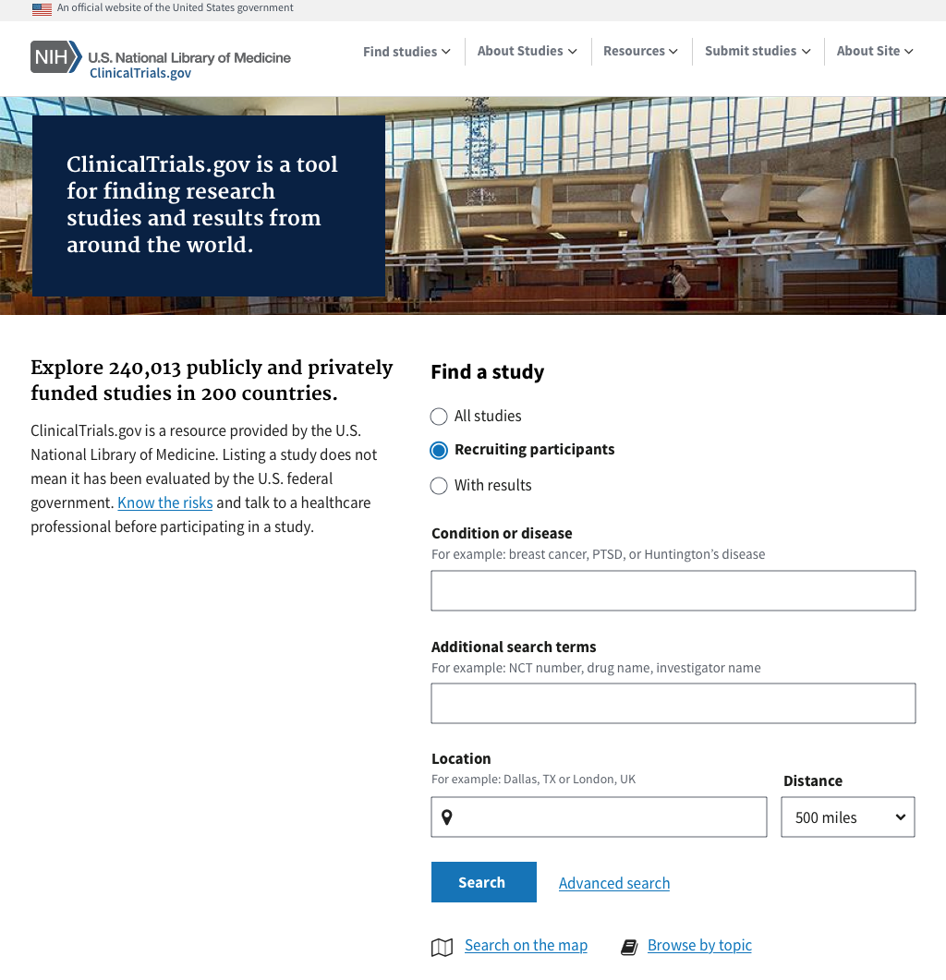
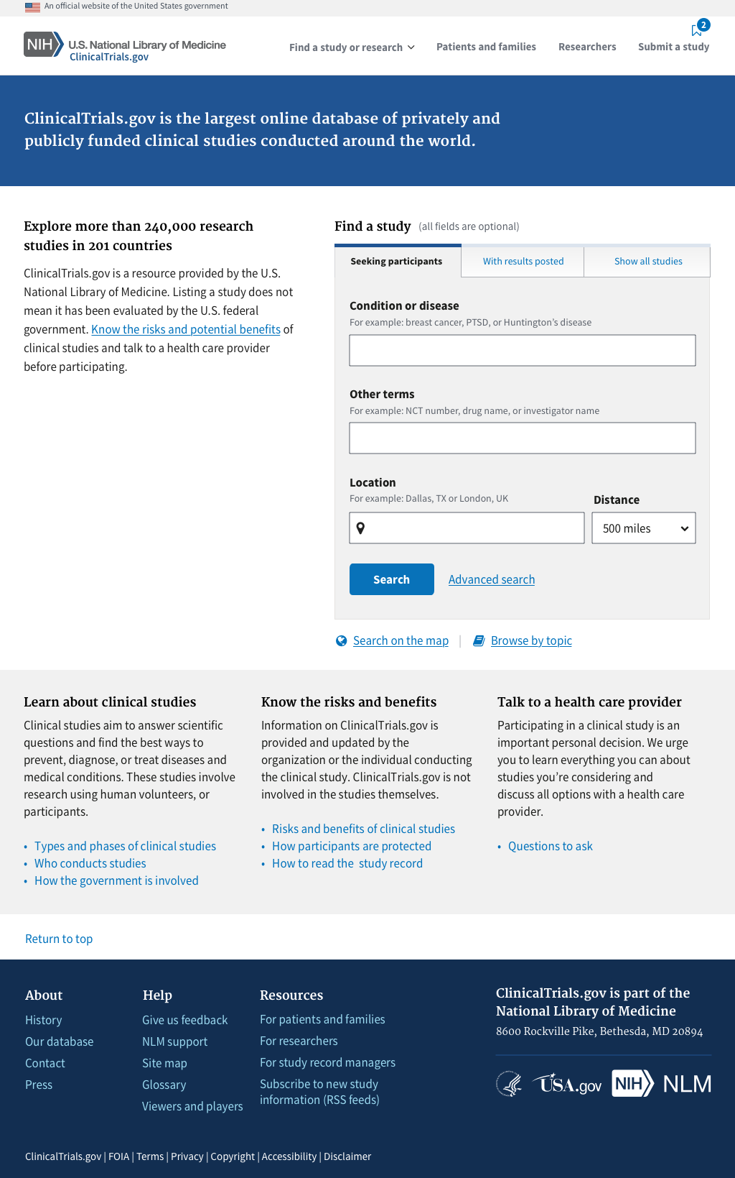
Learn from people and incorporate feedback
Sprint 1
Sprint 2
Beta launch design
Notes:
And because we are using the USWDS to prototype, it’s easy to evolve the design when we get feedback.

Slide 68





Product Owner
Tech Lead
Project Manager
Business Analyst
Procurement Specialist
Everyone has a role to play
Notes:
All of the people who will be needed to bring your product to life should be involved in the research planning and execution.

Slide 69
Research Lead
Note taker / Documenter
Interviewer/Moderator
Coordinator
Observer
Everyone has a role to play
Notes:
All of the people who will be needed to bring your product to life should be involved in the research planning and execution.

Slide 70
Good design habits to start practicing now
Notes:
I’ll leave you with some high level guidance on how to start practicing UCD

Slide 71


Do user research early and often
Rely on assumptions about your end-users
Notes:
[Read Slide]
There is no substitute for talking or observing real end users.
Even if you think you know your users and their struggles really well, you still need to keep them involved.

Slide 72
Explore multiple approaches
Double down on a single solution early
Notes:
[READ SLIDE]
Reduce risk of investing in the wrong thing by entertaining many ideas early on

Slide 73
Define the outcomes you want
Stick to a predefined solution
Notes:
[READ SLIDE]
Too often, people jump to a solution based on assumptions, before they fully understand the problem.

Slide 74
DevSecOps
Helping us build robust solutions that we can constantly test, integrate, and deploy
Notes:
Explain the term, differentiate between the product called Azure DevOps

Slide 75
Letting people and computers do the things they’re each good at
DevSecOps combines software development, security, and operations into one team, and automates as many of their processes as possible. People focus on the hard problems and let the computers handle the repetitive stuff.
Notes:
Computers are exceptionally good at doing the same thing over and over. People aren’t really that great at it - we get bored, we get distracted and forget a step, we forget to do the whole thing. In general it’s a good use of your computing resources to let them do the things they’re good at, and that frees up your people to do the things they’re good at too.

Slide 76

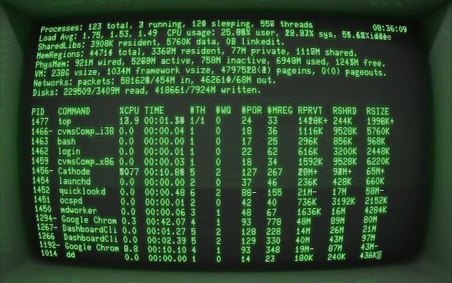
A manual deployment process
developers make a set of changes
staff do tests, often on their own computer
IT staff run security scans and approve or deny
product technical staff deploy the product
Notes:
Okay, so a quick deviation to what a traditional, manual deployment looks like. First a change happens. Or probably a bunch of changes, really. Then the product gets thrown over a wall for testing. This can be a group of staff who do tests by walking through a testing plan or reading change notes to figure out what to test. It may also be IT staff who run security scans or do compliance checks. If all that checks out, they throw it over another wall to technical staff who go about deploying the product. And they do that by typing in all the necessary commands in the right order.
Okay, let this sit in the back of your mind. We’ll revisit in a few minutes.

Slide 77
The DevSecOps culture
Open communications and knowledge sharing enhance trust within the team
Continuous feedback results in tighter processes that get better and better
Emphasizes the entire system, not just one piece, department, or interest
Experimentation lets us learn from successes and failures, constantly
Notes:
At its heart, DevOps is about culture, not any particular processes or patterns, though there are some common practices that have emerged and we’ll talk about those in just a second. But first I just wanted to introduce these key ideas that DevOps values.

Slide 78
DevSecOps covers three broad areas
Testing - Making sure things work as expected
Continuous Integration - Regularly making sure everything still comes together correctly
Continuous Delivery - Regularly publishing the latest version of the product for users to use
Notes:
The philosophy of devops is important, but it’s also hand-wavy and just talk, so let’s get into some of the practices that devops has embraced and how they support that philosophy - and our larger goals of user-centered design and continuous, iterative improvement.

Slide 79
1/ Testing

Slide 80
Does it do what it’s supposed to? Do the things that worked yesterday still work today?
Testing is about making sure the application does what it’s supposed to and catching bugs as early as possible.
Notes:
Tests are intended to catch bugs before the users have to see the software. Once a feature is done and has been validated by users, tests should alert you to any bugs that break that future in the future before users even have to see it.

Slide 81
Testing the product
1
Assert what the features of the application should do:
hello-app
assert screen-output = “Hello!”
Notes:
We’re going to walk through an example using test-driven development, where we create the tests before we write the code. In this case, we’re creating a feature that writes the word hello to the screen, so our test runs the app and then asserts that that’s what happens.

Slide 82
Testing the product
1
Assert what the features of the application should do:
hello-app
assert screen-output = “Hello!”
2
Write some code to implement those features:
puts “Hello!”
Notes:
Next we write some code to implement that feature. This is real code, incidentally - it’s in a programming language called Ruby.

Slide 83
Testing the product
1
Assert what the features of the application should do:
hello-app
assert screen-output = “Hello!”
2
Write some code to implement those features:
puts “Hello!”
3
Execute the tests to make sure the application does what we expect:
Finished in 0.3s, 1 assertion
0 failures, 0 errors
Notes:
Then we execute the tests. If everything passes, we get 0 failures or errors and if are tests are good, we can be confident that the software works as intended. This is a really simple test, but it actually does a few things for us. One, it makes sure that “Hello” is printed to the screen. Two, if there’s ever a bug that changes what gets printed to the screen, this test will catch it. That is, good tests are also automatically regression tests. Third, this is a form of documentation - reading the tests can tell us what the expected behavior is.

Slide 84
2/ Continuous Integration

Slide 85
Making sure the different parts go together, each step of the way
Continuous integration is taking each change, as it happens, and checking whether it breaks the product. This way the team knows quickly, as soon as a change is made, rather than days or weeks later.

Slide 86
From many, one
start

Slide 87
From many, one
start
developer 1

Slide 88
From many, one
start
developer 1
developer 2
developer 3

Slide 89
From many, one
start
developer 1
developer 2
developer 3

Slide 90
From many, one
start
developer 1
developer 2
developer 3

Slide 91
From many, one
start
developer 1
developer 2
developer 3

Slide 92
From many, one
start
finish
developer 1
developer 2
developer 3

Slide 93
That looks like a disaster about to happen...

Slide 94
Everything is okay...
start
developer 1
tests
Notes:
Continuous integration is a natural time to run your tests. And this isn’t just the code tests you wrote like in the previous section. This can also be your security scans, like OWASP, or your dependency vulnerability scans. This can be code quality scans. You can really put all kinds of tests and scans into your continuous integration. The goal is to ensure that at each step, you can take that step’s work and put it into the product seamlessly without degrading the overall product quality.

Slide 95
...and it’s still okay...
start
developer 1
developer 2
developer 3
tests
tests

Slide 96
...and it’s still okay...
start
developer 1
developer 2
developer 3
tests
tests
tests

Slide 97
...and it’s still okay...
start
developer 1
developer 2
developer 3
tests
tests
tests
tests

Slide 98
...and it’s still okay...
start
developer 1
developer 2
developer 3
tests
tests
tests
tests
tests

Slide 99
...and everything is good!
start
finish
developer 1
developer 2
developer 3
tests
tests
tests
tests
tests

Slide 100
3/ Continuous Delivery

Slide 101
Making the new, updated product available as often as possible
Continuous delivery is about deploying the most recent version of your product. That means every time some changes gets pulled into the app, the app gets deployed again.
Notes:
This slide says “every change,” but you don’t actually have to deploy after every single change. You may have some kind of gating or code promotion processes that dictate when deployments happen. You can also have multiple deployments - one that goes up for user research to validate new features before releasing them publicly, for example. These can have different rules and whatnot, but the goal is to always have the most recent relevant version deployed in each environment.

Slide 102

The delivery
Something changes...

Slide 103



The delivery
Something changes...
...which is a signal for continuous integration to start...
Notes:
Continuous integration is usually treated as a single action here, even though it may be composed of several actions. If the tests fail, or if the security scans fail, or whatever else fails, then the integration fails.

Slide 104



The delivery
Something changes...
...which is a signal for continuous integration to start...
...which means it’s time for deployment
Notes:
A deployment is the process of releasing a new version of your product. That could be deploying a website, maybe it’s publishing an app to the app store, or maybe it even installs it directly on users’ desktop computers.
There are a few benefits of delivering continuously. One, clearly, is being able to get rapid user feedback. Another is that sometimes changes cause deployment failures but not integration failures, and continuous delivery will allow you to identify those quickly. And another big one is that these deployments become routine and boring instead of big exciting events that require all-hands-on-deck.

Slide 105
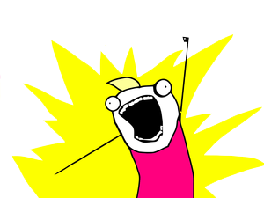
4/ Automate
ALL THE THINGS

Slide 106
A manual deployment process
developers make a set of changes
staff do tests, often on their own computer
IT staff run security scans and approve or deny
product technical staff deploy the product
Notes:
Okay, before we get to automating, we need to address the very first step, right? Because if we’re doing continuous integration and deployment, we don’t want to wait for a set of changes.

Slide 107
A manual deployment process
a developer makes a change
staff do tests, often on their own computer
IT staff run security scans and approve or deny
product technical staff deploy the product
Notes:
We want to handle each change. Next, if we want this to be continuous, we have to start reconsidering the human elements. Every time human intervention is necessary, that creates uncertain delays. So let’s look at this first one. There are some big gotchas here. For example, how do you know the staff are running the right tests each time? And how long does it take them to go through everything? And if they really are running the tests on their own computers, how will they ever catch bugs that only happen in a deployment environment? So this manual step introduces a delay and uncertainty. So we can get rid of that.

Slide 108
A continuous deployment process
a developer makes a change
CI process detects change and runs tests
IT staff run security scans and approve or deny
product technical staff deploy the product
Notes:
There we go. As soon as the change happens, the CI process kicks off. There’s still a blocker of IT needing to run security scans and those kinds of things. So there’s uncertainty there too.

Slide 109
A continuous deployment process
a developer makes a change
CI process detects change and runs tests
CI process also runs security & compliance scans
product technical staff deploy the product
Notes:
Cool, more stuff that just happens, less uncertainty! And what’s left is, honestly, the biggest source of uncertainty in the whole process. Deploying a product requires a specific sequence of steps. If you miss one or you typo something, you can bring the whole system down. This is risky, and one of the reasons businesses often deploy infrequently is because doing this by hand is nerve-wracking. People are forgetful. It’s really, really easy to forget a step or think you’ve already done it.

Slide 110

A continuous deployment process
a developer makes a change
CI process detects change and runs tests
CI process also runs security & compliance scans
CD process deploys when builds finish
Notes:
But it doesn’t have to be. Remember the goal is to make it routine and boring. Once you get the deployment process figured out, you can put it into code and let computers do it. They are awesome at doing the same thing over and over. Another big advantage is that your deployment is in code, which means you can track how it changes over time. If it ever breaks, you can use that change history to look back and see where it went wonky and that can help you diagnose it.

Slide 111
A continuous, automated deployment process
a developer makes a change
CI process detects change and runs tests
CI process also runs security & compliance scans
CD process deploys when builds finish
This is the only manual step!
Notes:
Now, this might look scary because you don’t want every change going to your users or on to your production systems all willy-nilly. That is absolutely correct, we don’t want that. Instead, we might setup multiple different environments, meaning there’s the “real” website but there’s also a “test” website that gets updated all the time. That test website is where we’d do user testing on new features before they go live, for example. So we definitely don’t want our real app getting pushed out to people every few hours as developers make changes, and we have ways of handling that.

Slide 112
A continuous, automated deployment process
a developer makes a change
CI process detects change and runs tests
CD process starts a build when tests pass
CD process deploys when builds finish
You can enforce specific conditions at each step
Notes:
You can have these kinds of gates at each step. Code reviews. And if the tests fail, we don’t move on to continuous delivery. And maybe when we get to deployment, there’s a check that says, oh hey, this is our testing code branch, so we’re going to deploy into the testing environment instead of our production one.
What’s really cool about this is because our infrastructure is automated - that is, we create it on the fly, as we need it - and because configuring that infrastructure and deploying and everything is all automated, it’s trivial to create as many of these environments as we want. Three or four is pretty common these days, but if you want more, that’s easy to do.

Slide 113
The key takeaway:
DevSecOps is an enabler for continuous, iterative improvement
Notes:
DevOps does not create continuous improvement, but it creates a culture where it’s easier and more possible. Building up the trust between the various interests is critical. For example, you can’t automate security scanning in a meaningful way until the security staff trust the product owner. And the product owner probably doesn’t want to invest in that automation unless they trust the security staff. If they agree to a set of required scans and they each trust the other, then you can automate it and each side trusts the other that it’s right. And that trust comes from open communication, quick feedback, and viewing the system as a whole instead of collection of parts. One team working towards one outcome, not one team relying on multiple other teams.

Slide 114
Agile acquisitions
Structuring RFPs to support modern development practices

Slide 115

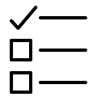
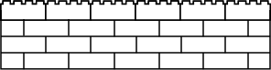

The traditional way of approaching ‘big bang’ procurements
FROM
Years
Notes:
Traditional government way (How Kodak did it with IBM):
Long time to write the RFP and award the contract
Vendors build on proprietary, outdated systems - causing vendor lock in to maintain
Locked in with a single vendor - less motivation for the vendor to perform or cut costs
Black box development environment - no window into what is being built until it is delivered
Change orders ($$$) when inevitable changes need to be made due to policy shifts
Assumes Gov’t and vendor need to know “every requirement” prior to awarding a contract.
System takes years to deliver, but doesn’t meet user needs
Frustration on Bothsides
Susceptible to protests (i.e. delays)
Govt stakeholders and the vendors are not happy - turns to finger pointing
Systems are outdated by the time they go into production
Illustration: Requirements > Solicitation > Build > Use (If it works)
Modular way:
Assumes things change (agile practices)
- Constant feedback on product being developed (agile practices)
Build in 2-6 months - Delivery is the Strategy:
If only have 60 days, have to dedicate time energy to viable product
Shorter Procurement Times (show vs. tell)
Forces vendors and buyers to focus on building di
Traditional government way:
Long time to write the RFP and award the contract
Vendors build on proprietary, outdated systems - causing vendor lock in to maintain
Locked in with a single vendor - less motivation for the vendor to perform
Black box development environment - no window into what is being built until it is delivered
Change orders ($$$) when inevitable changes need to be made due to policy shifts
Assumes Gov’t and vendor need to know “every requirement” prior to awarding a contract.
System takes years to deliver, but doesn’t meet user needs
Frustration on Bothsides
Susceptible to protests (i.e. delays)
Govt stakeholders and the vendors are not happy - turns to finger pointing
Systems are outdated by the time they go into production
Illustration: Requirements > Solicitation > Build > Use (If it works)
Modular way:
Assumes things change (agile practices)
- Constant feedback on product being developed (agile practices)
Build in 2-6 months - Delivery is the Strategy:
If only have 60 days, have to dedicate time energy to viable product
Shorter Procurement Times (show vs. tell)
Forces vendors and buyers to focus on building discrete things (best in class vs. passing through prime to get to sub)
Scoped to what user needs are (user centered design)
= Build in space to involve users in the process
SW developed in a way that it is usable by other vendors, government teams, and partner industries (open source)
SW developed by smaller, more efficient teams
Illustration: Discovery > Solicitation > Build/use > repeat

Slide 116
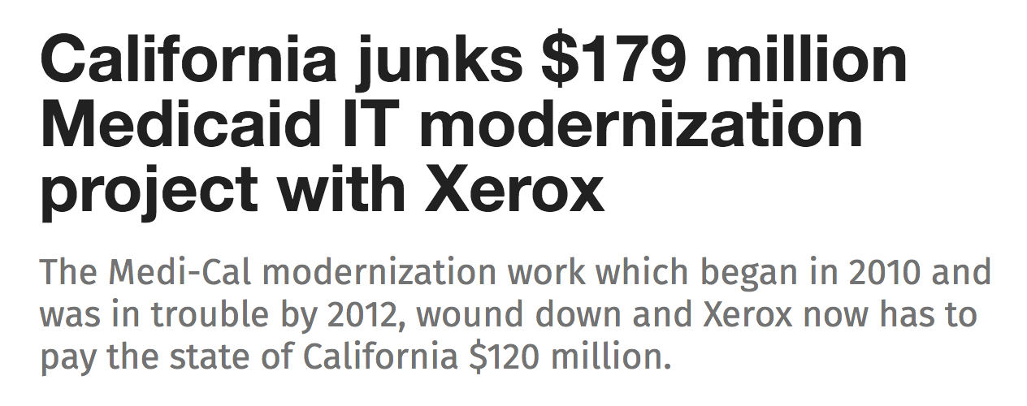
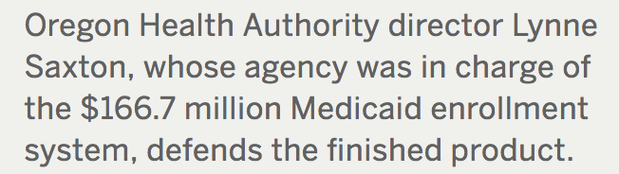
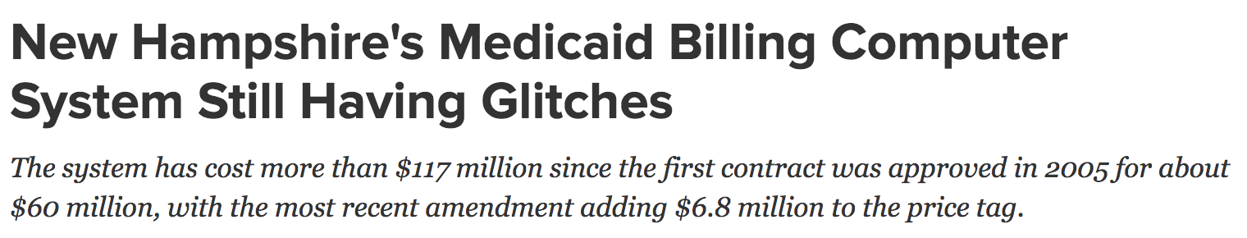
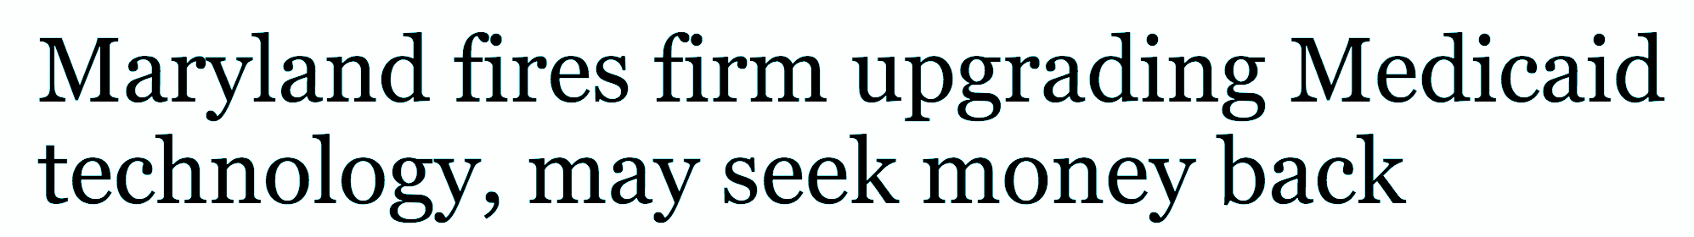
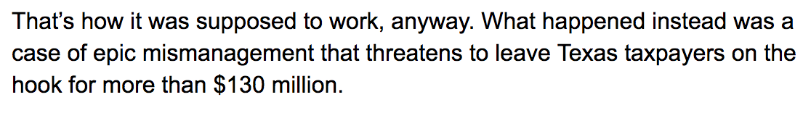
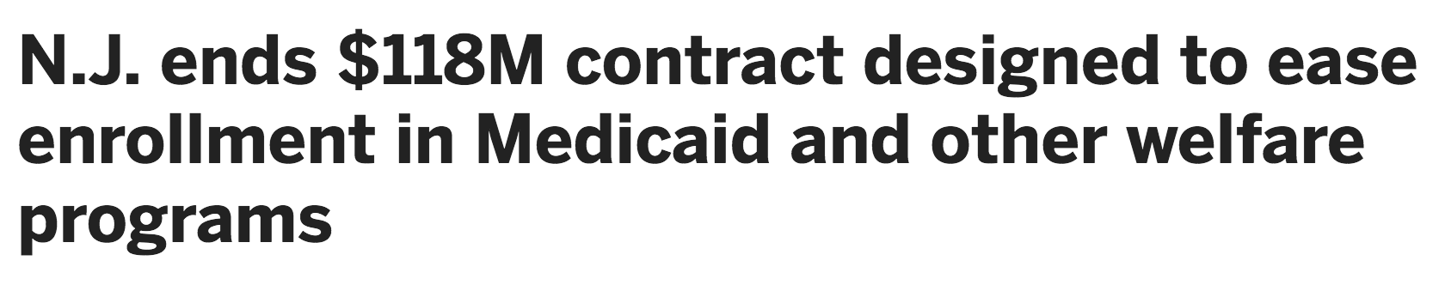
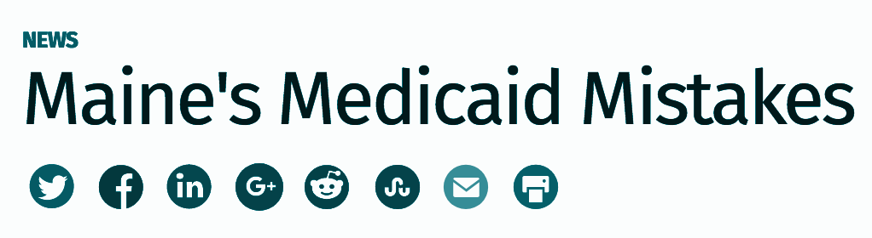
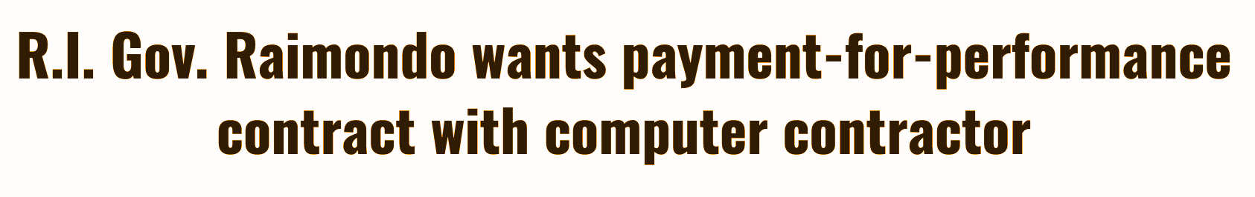
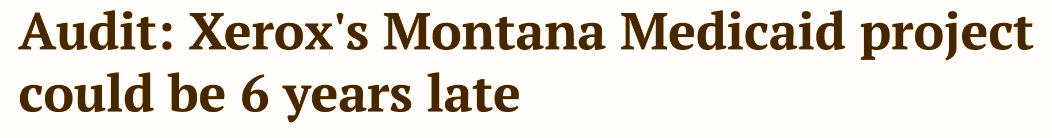
It’s risky and makes juicy headlines

Slide 117
Thinking differently about requirements

Slide 118
User needs
Backlog
Delivery
Release 1
Release 2
Release 3
Release 4
We know these elements need to be part of an agile software process.

Slide 119

Achieving a vision
Plan-driven
Iterative
Start
Start
Desired outcome
Desired outcome

Slide 120
Achieving a vision
Plan-driven
Iterative
Start
Start
Desired outcome
Desired outcome

Slide 121
User needs
Backlog
Delivery
Release 1
Release 2
Release 3
Release 4
Don’t confuse the destination
for the journey.
Notes:
Far less important than magically landing on the far right column of structured, orderly releases from the general chaos of ungroomed requirements. Acquiring a team that can undertake that process in the appropriate role is far more important and the target of any acquisition.
How to make the shift from column to column is the self-organizing product team’s decision. When to make the shift is a negotiated outcome between that team and the users.

Slide 122
Backlog
This is the journey.
You pursue a vision with a dedicated product team.
Organizational goals
+
User needs

Slide 123
Release 1
If you try to skip to the end, you’ve destroyed iterative modularity. Defining this up front is waterfall.
Release 1
Release 2
Release 2
Release 3
Release 3
Release 4
Release 4

Slide 124

The traditional approach to solving the incompleteness problem is trying to do a “better” up-front inventory:
More time spent
More people involved
More “requirements,” either actual or potential, captured in writing.
It’s a fantasy that doesn’t work.

Slide 125
You cannot achieve a different output unless you change the input.

Slide 126
Organizational goals
Backlog
Delivery
Release 1
Product vision
Release 2
+
User needs
Release 3
Release 4
Two key artifacts bridge contracting and agile software development: the product vision and a prioritized backlog of work to do.

Slide 127
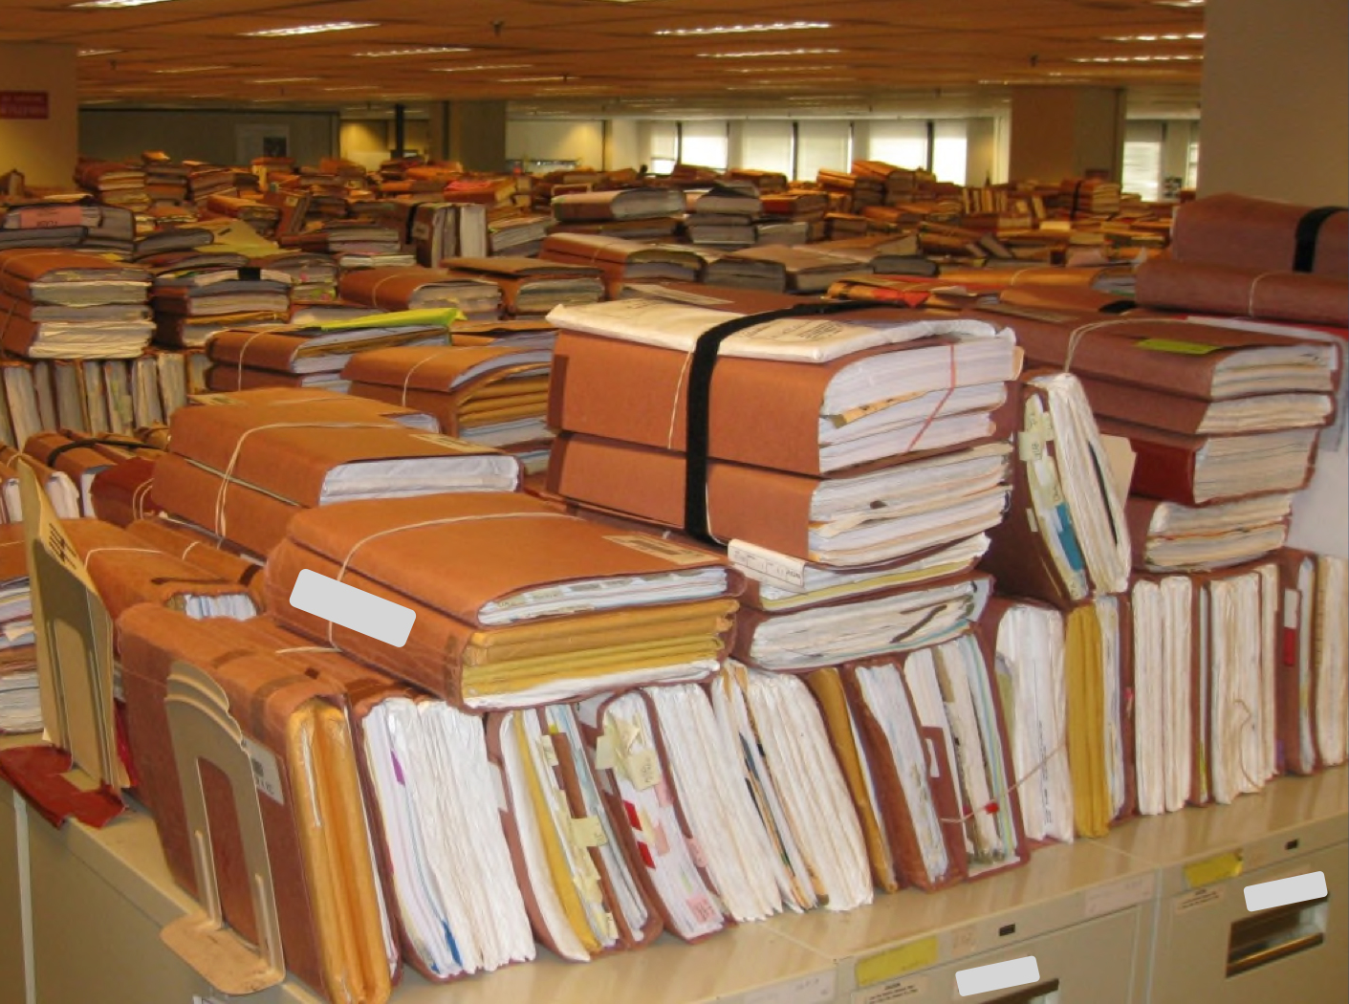
Contracts must also change to support this new, Agile approach
Adhering to Agile principles means that government as a buyer must be descriptive, not prescriptive.

Slide 128

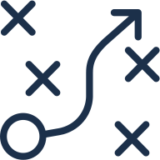

Procurement Principles
Structure contracts to focus on working software, not planning documentation
Structure contracts to lower costs and avoid vendor lock-in. Reduce switching costs.
Find vendors that use human-centered design to focus on software that meets people’s needs
Ensure full transparency on the vendor team - working code to actual users seen early and often
Leverage open-source software, and select modern tech stacks to ensure long-term sustainability
Collaboration with vendor teams vs. constant negotiation.

Slide 129
Remember what you’re buying
With agile contracting, you’ll be buying teams of developers and other experts from vendors.
Remember, this isn’t a product — it’s the skills and expertise required to make and maintain a product. That’s what lets you be flexible.

Slide 130
What does quality look like?
Communicate with vendors about what you expect in working software. For example, a Quality Assurance Plan should include measures:
Tested Code
Properly Styled Code
Accessible
Deployed
Documented
Available
Secure
User Research and Design Artifacts
Notes:
SOO tells you the outcome you’re looking for.
SOW tells the vendor how to perform these functions, which is not why you’re paying.
The FAR’s statement of objectives forces the government to be descriptive, and plugging the scrum artifacts into it creates the core artifact—the Agile Contract Format to guide the rest of the process.

Slide 131
How does this work in practice?
Outreach: Find quality companies that you’d like to bid. Get them excited about what you’re trying to do.
Transparency: Get vendors’ feedback on a draft RFP.
Brevity: Don’t ask for 100’s of pages of proposals. Consider using verbal interviews to get a sense of team dynamic.
Post-award management: Gov’t owns the product decisions, but works collaboratively with the vendor. Use a Quality Assurance Surveillance Plan so vendors know what’s expected from their research and coding activities.

Slide 132
Questions & discussion

